Slide 1
The Greedy Design Technique-1
Lecture-4: Fractional Knapsack & Car Fueling
Md. Golam Shahriar,
Lecturer, Dept. of CSE, VU

Slide 2
The Greedy Design Principles
A game like chess can be won only by thinking ahead: a player who is focused entirely on immediate advantage is easy to defeat.
But in many other games, such as Scrabble, it is possible to do quite well by simply making whichever move seems best at the moment and not worrying too much about future consequences.
Greedy algorithms build up a solution piece by piece, always choosing the next piece that offers the most obvious and immediate benefit.
There must be two properties in a problem for a greedy strategy to work:
It has optimal sub-structures. Optimal solution to the problem contains optimal solutions to the sub-problems.
It has the greedy property (difficult to prove in time-critical environment!). If we make a choice that seems like the best at the moment and proceed to solve the remaining sub problem, we reach the optimal solution. We will never have to reconsider our previous choices.

Slide 3
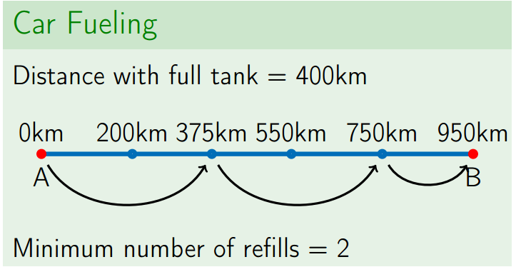

The Car Fueling Problem
Input: A car which can travel at most $L$ kilometers with full tank. A source point $A$ and a terminal point $B$ is given along with $n$ gas stations at distances $x_{1}≤x_{2}≤..≤x_{n}$ in kilometers along the path from $A$ to $B$.
Output: The minimum number of refills to get from $A$ to $B$ besides an initial refilling at $A$.

Slide 4
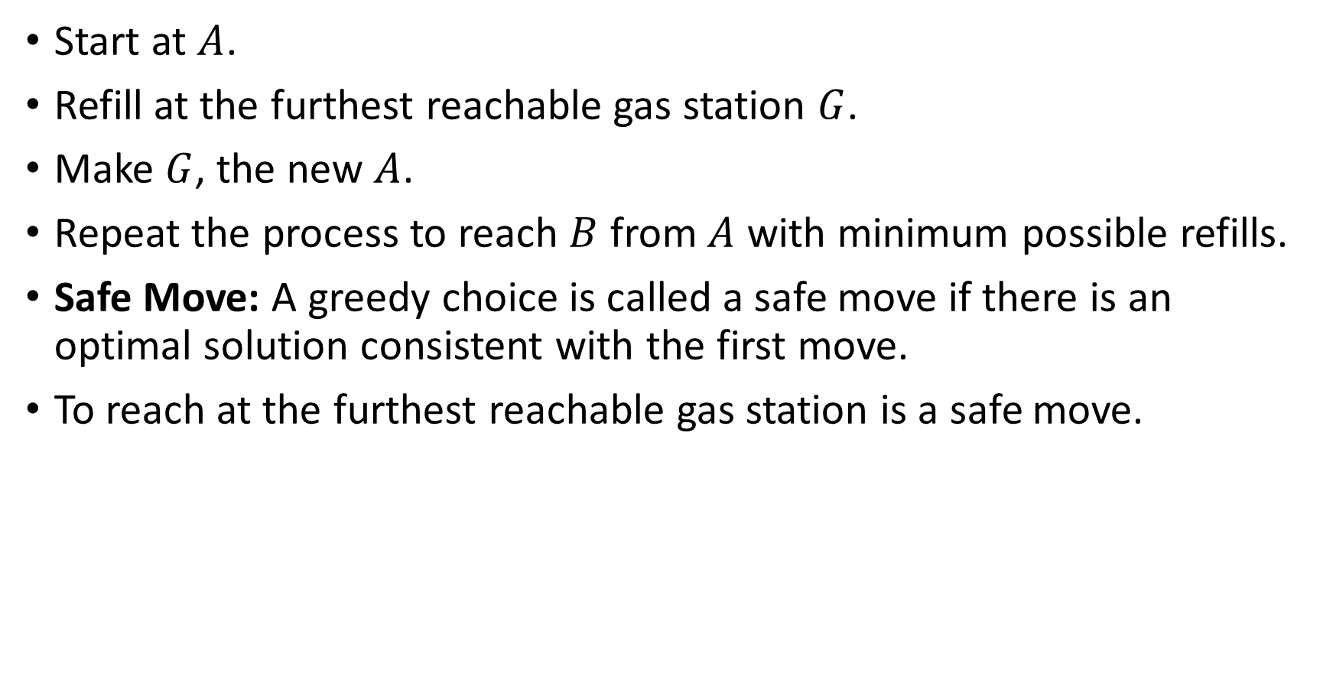
A Reasonable Algorithm With Greedy Choice
Start at $A$.
Refill at the furthest reachable gas station $G$.
Make $G$, the new $A$.
Repeat the process to reach $B$ from $A$ with minimum possible refills.
Safe Move: A greedy choice is called a safe move if there is an optimal solution consistent with the first move.
To reach at the furthest reachable gas station is a safe move.

Slide 5
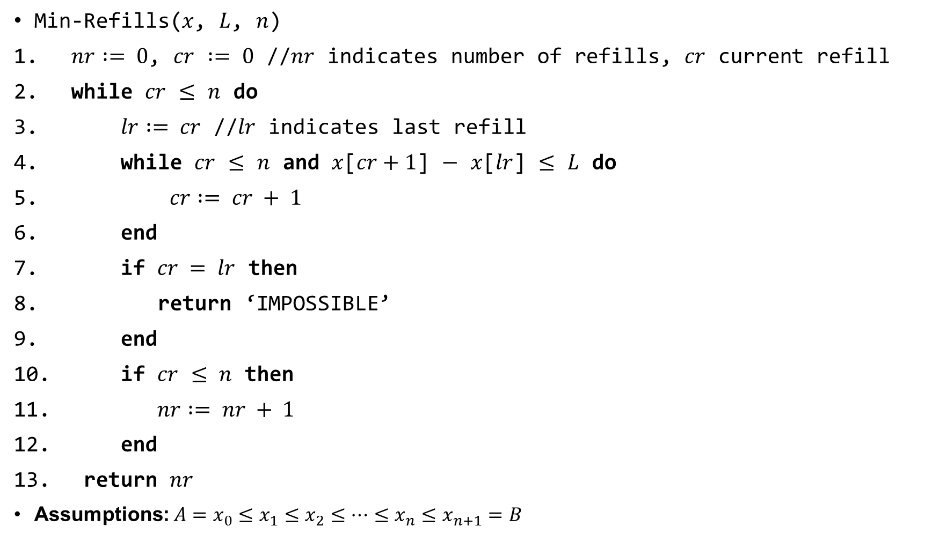
The Algorithm
Min-Refills($x$, $L$, $n$)
$nr := 0$, $cr$ $:= 0$ //$nr$ indicates number of refills, $cr$ current refill
while $cr$ $≤$ $n$ do
$lr := cr$ //$lr$ indicates last refill
while $cr$ $≤$ $n$ and $x$[$cr+1$] $−$ $x$[$lr$] $≤$ $L$ do
$cr := cr + 1$
end
if $cr = lr$ then
return ‘IMPOSSIBLE’
end
if $cr$ $≤ n$ then
$nr := nr + 1$
end
return $nr$
Assumptions: $A=x_{0}≤x_{1}≤x_{2}≤…≤x_{n}≤x_{n+1}=B$

Slide 6

Run Time
The algorithm runs in $O(n)$.
$cr$ changes from $0$ to $n(=x.length)$ one-by-one and at most $n$
$cr$ controls the execution of both while loops.

Slide 7
Another Greedy Algorithm: Fractional Knapsack
Suppose that you are going for a long hike. You want take some foods with you but the bag that you can carry, only has a limited capacity of.
Your goal is to fill your bag with as much of food item as possible.
The problem is called fractional because you can cut out a portion of your food item to put in your bag(knapsack).
This optimization problem can be solved using greedy approach because we are allowed to take a portion of our food items rather than taking it as a whole.
Each food item has calories associated with it.

Slide 8

The Fractional Knapsack Problem Formalization
Input: weights $w_{1}…w_{n}$ and values $v_{1}…v_{n}$ of $n$ items. Capacity $W$.
Output: The maximum total value of fractions of items that fits into the $W.$

Slide 9
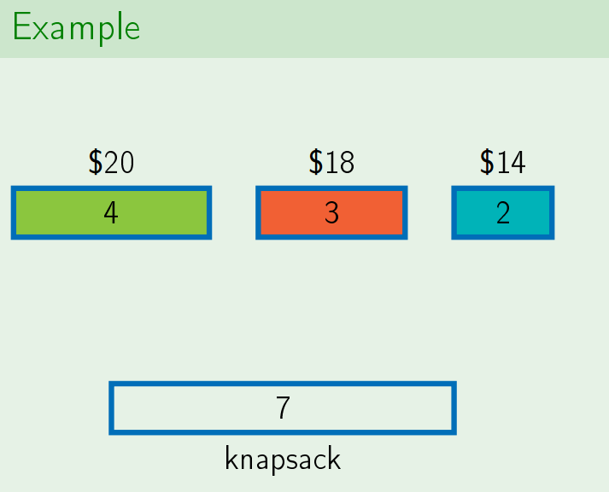

Slide 10
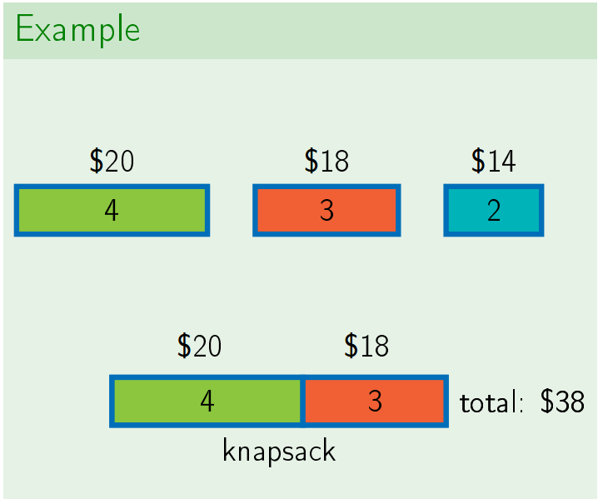

Slide 11
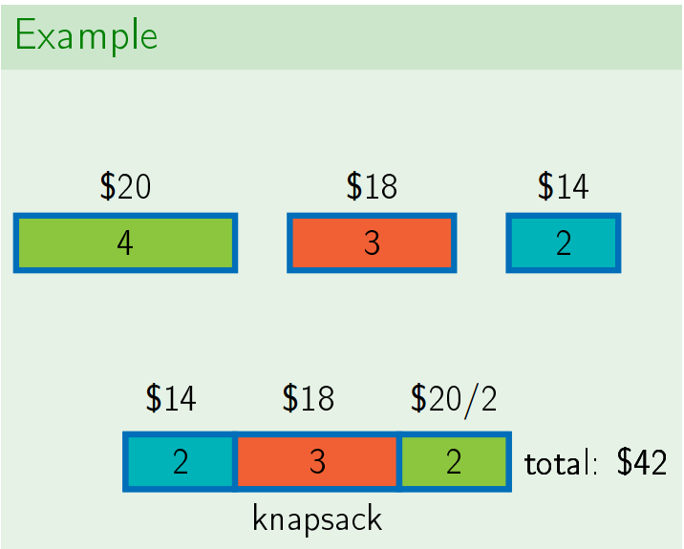

Slide 12
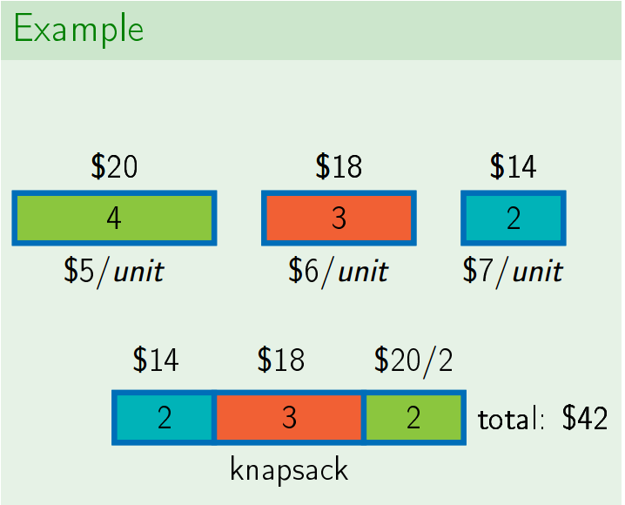

Slide 13
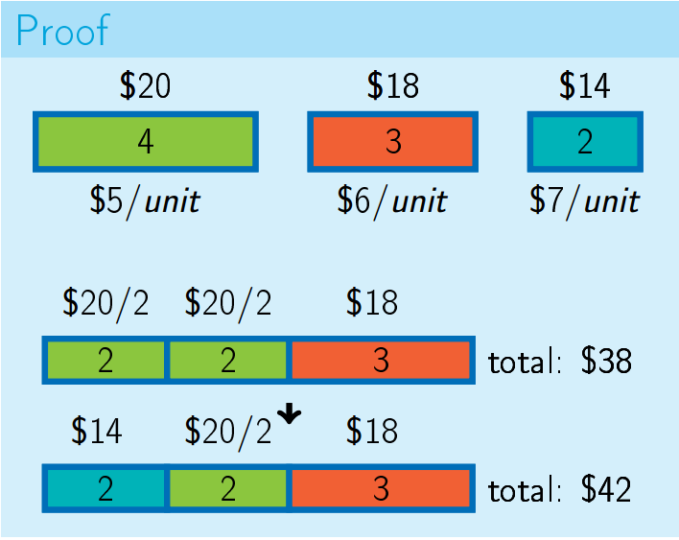
Safe Move
There exists an optimal solution that uses as much as possible of an item with the maximal value per unit of weight.

Slide 14
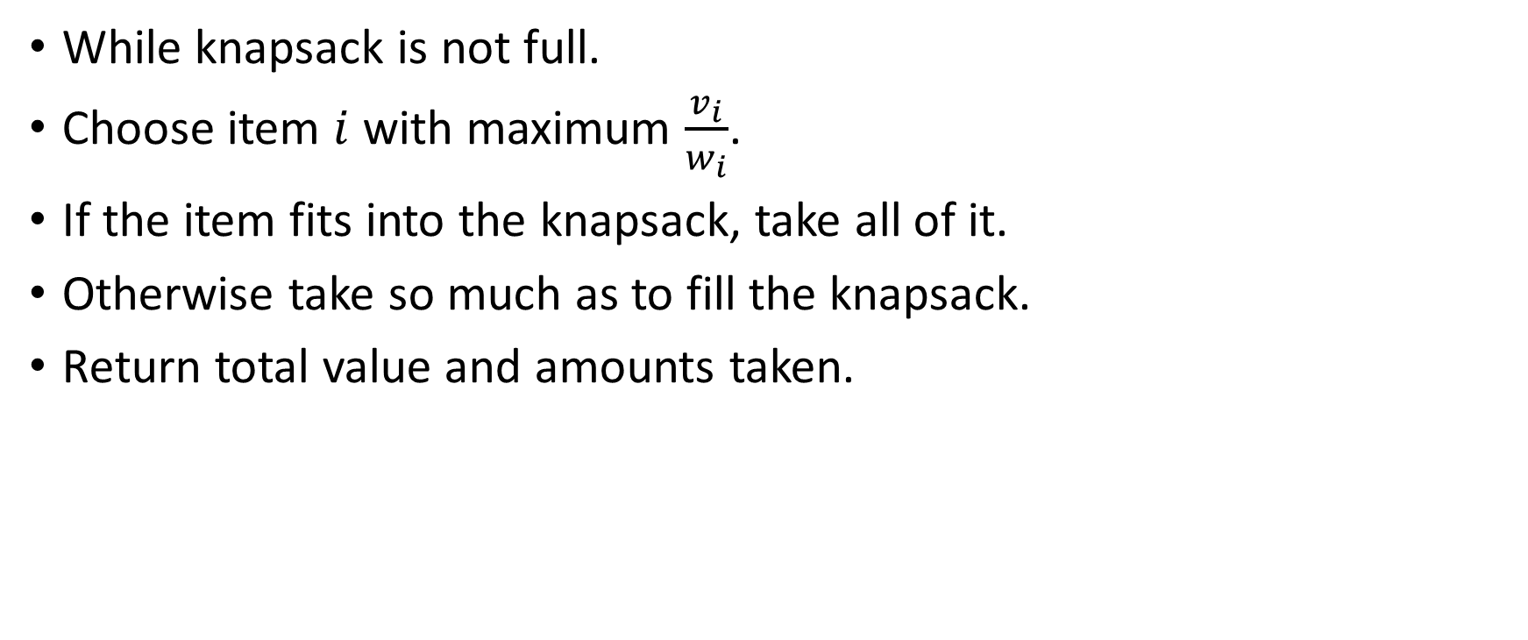
The Greedy Algorithm
While knapsack is not full.
Choose item $i$ with maximum $\frac{v_{i}}{w_{i}}$.
If the item fits into the knapsack, take all of it.
Otherwise take so much as to fill the knapsack.
Return total value and amounts taken.

Slide 15
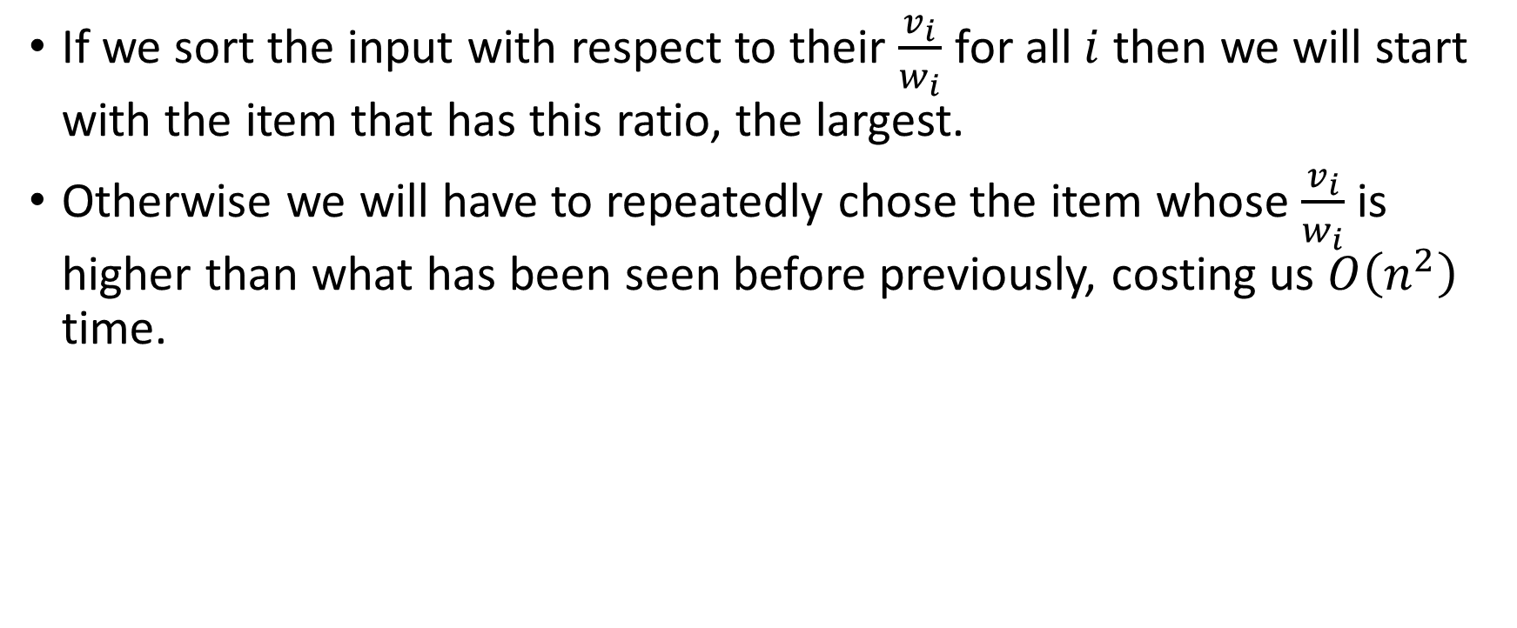
Some Observations
If we sort the input with respect to their $\frac{v_{i}}{w_{i}}$ for all $i$ then we will start with the item that has this ratio, the largest.
Otherwise we will have to repeatedly chose the item whose $\frac{v_{i}}{w_{i}}$ is higher than what has been seen before previously, costing us $O\left(n^{2}\right)$ time.

Slide 16
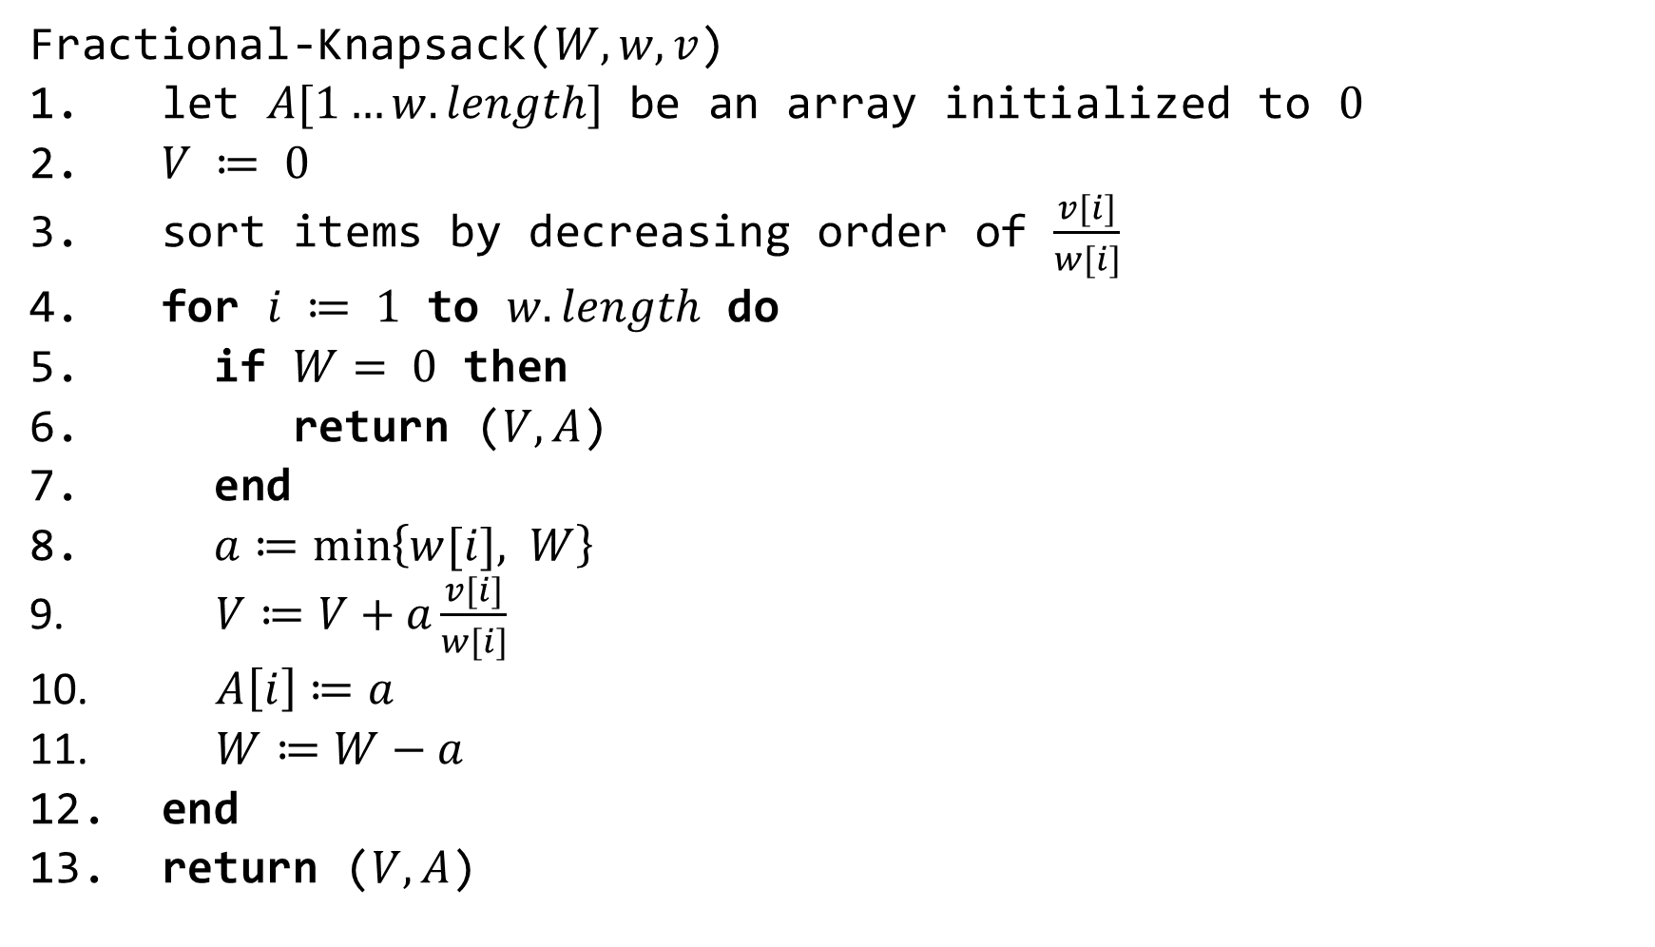
A Better Algorithm
Fractional-Knapsack($W, w, v$)
let $A[1…w.length]$ be an array initialized to $0$
$V ≔ 0$
sort items by decreasing order of $\frac{v[i]}{w[i]}$
for $i ≔ 1$ to $w.length$ do
if $W= 0$ then
return ($V, A$)
end
$a≔\min\left\{w[i], W\right\}$
$V≔V+a\frac{v[i]}{w[i]}$
$A\left[i\right]≔a$
$W≔W−a$
end
return ($V, A$)

Slide 17

The Running Time
Note the runtime $T\left(n\right)=O\left(n\right)+O(n\lg{n})$.
The first $O\left(n\right)$ is the number of iterations and the second $O(n\lg{n})$ is the time taken for sorting.
Since $n=O(n\lg{n})$ we can conclude that $T\left(n\right)=O(n\lg{n})$

Slide 18
Review of The Greedy Strategy: Reduction to Subproblem
Make a first move
Then solve a problem of the same kind
Smaller: fewer weight capacity left, fewer fuel stations etc. This is called a “subproblem”

Slide 19
Review of The Greedy Strategy: Safe Move
A move is called safe if there is an optimal solution consistent with this first move
Not all first moves are safe

Slide 20
